Slide 1
Language Processing Term Project ??
INDIAN INSTITUE OF TECHNOLOGY,KHARAGPUR
Dimpi Saikia 15CS60R08
Kalyani Roy 15CS60R20
Gowtham Nayak 15CS60R22
Survi Makharia 15CS60R02
Under the Guidance
of
Dr Plaban Bhowmick

Slide 2
Contents
Introduction
Learning Approach
Training Data
Feature Selection
Classifier
Testing/Accuracy
Conclusion

Slide 3
Introduction
I have No intricate details about he project ☺

Slide 4
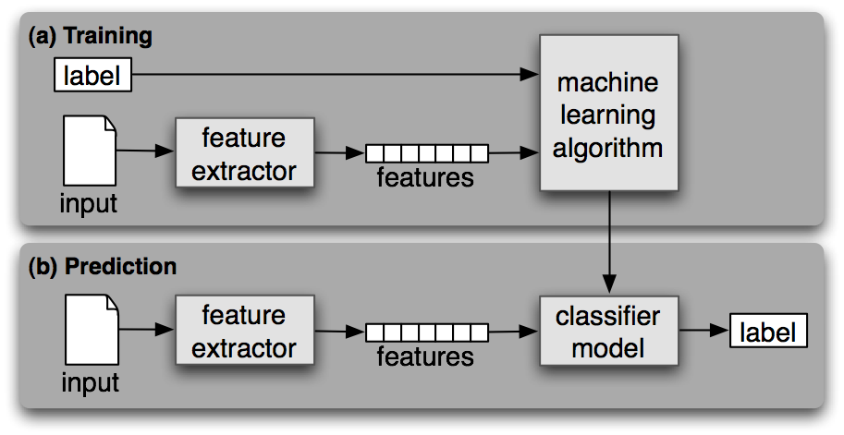
Learning Approach: Supervised
A classifier is called supervised if it is built based on training corpora containing the correct label for each input.
The framework used by supervised classification is shown .

Slide 5
Training Data
Training Corpus
Training Document Size(AVG)
Training Document Number(max)
Classification Labels : Grade1-Grade10

Slide 6
Feature Selection
Detecting patterns is a central part of Natural Language Processing.
But how did we know where to start looking, which aspects of form to associate with which aspects of meaning?
The goal here is to answer the following questions:
How can we identify particular features of language data that are salient for classifying it?
How can we construct models of language that can be used to perform language processing tasks automatically?
What can we learn about language from these models?

Slide 7
Feature Selection
Selecting relevant features and deciding how to encode them for a learning method can have an enormous impact on the learning method's ability to extract a good model.
Much of the interesting work in building a classifier is deciding what features might be relevant, and how we can represent them.
Although it's often possible to get decent performance by using a fairly simple and obvious set of features, there are usually significant gains to be had by using carefully constructed features based on a thorough understanding of the task at hand.
Typically, feature extractors are built through a process of trial-and-error, guided by intuitions about what information is relevant to the problem.

Slide 8
Features : Unigram Count
Analysis: roy fill it
Steps:
Observation:

Slide 9
Features : Sentence Length
Analysis: dimpi fill it
Steps:
Observation:

Slide 10
Features : Average Word Length
Average Word length is the total occurrences of terms normalized by number of terms. Stop words are not excluded for this measure.
Steps: Input Document is taken and split into individual terms.
Length of each term is calculated (len i).
The number of individual words are computed(num).
Average word length= Σ i=1 to n {(len i)/num}
Observation: Plots Required

Slide 11
Document Classification
Using these corpora, we can build classifiers that will automatically tag new documents with appropriate category labels.

Slide 12
Classifier : Naïve Bayes
In naive Bayes classifiers, every feature gets a say in determining which label should be assigned to a given input value. To choose a label for an input value, the naive Bayes classifier begins by calculating the prior probability of each label, which is determined by checking frequency of each label in the training set.
The contribution from each feature is then combined with this prior probability, to arrive at a likelihood estimate for each label.

Slide 13
Testing/Accuracy

Slide 14
Conclusion

Slide 15
References
Martin, James H., and Daniel Jurafsky. "Speech and language processing."International Edition (2000).
Jurafsky, Dan. Speech & language processing. Pearson Education India, 2000.
http://www.nltk.org/book_1ed/
Speech and Language Processing: An Introduction to Natural Language Processing

Slide 16
END

